Slide 1
CCNA: INTRODUCTION TO NETWORKS
Module 1: Networking Today

Slide 2
NETWORKING TODAY
What students learn in this module?
What is Computer Network?
Network Components
Network Representation and Topologies
Common Types of Networks
Internet Connection
Reliable Networks
Network Security
The IT Professional

Slide 3
NETWORKING TODAY

Slide 4
What is Computer Network?
Computer Network?
A computer network is a collection of interconnected devices, including networking hardware such as routers and switches, as well as end-user devices like computers, smartphones, and printers.
Network Functions?
These devices communicate with each other to share resources, exchange data, and facilitate various activities, from file sharing to internet access.

Slide 5
NETWORK COMPONENTS

Slide 6
NETWORK COMPONENTS
NETWORKING DEVICES & END DEVICES
Networking Devices:
End Devices:
Routers: These devices manage traffic between different networks and direct data packets between them, ensuring that information is sent to the correct destination.
Switches: Switches connect devices within a single network, forwarding data only to the specific device that needs it, which helps optimize network efficiency.
These are the devices users interact with, such as desktop and laptop computers, smartphones, tablets, and printers. They serve as endpoints in a network where data can be sent or received.

Slide 7
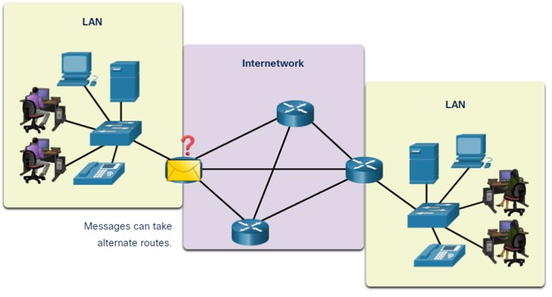
NETWORK COMPONENTS (CONT)​
End device is where a message originates from or where it is received. data originates with an end device, flows through the network, and arrives at an end device.

Slide 8
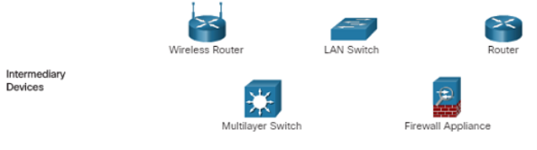
NETWORK COMPONENTS (CONT)​
An intermediary device interconnects end devices. Examples include switches, wireless access points, routers, and firewalls.​
Management of data as it flows through a network is also the role of an intermediary device, including:​
Regenerate and retransmit data signals.​
Maintain information about what pathways exist in the network.​
Notify other devices of errors and communication failures.

Slide 9
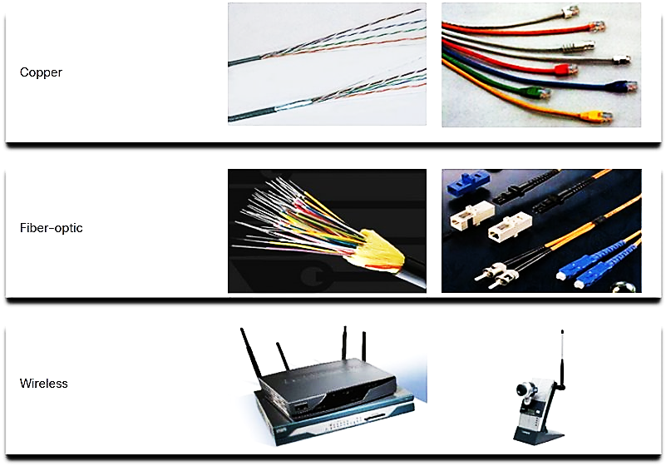
NETWORK COMPONENTS
Network Media
Media Types | Description
Metal wires within cables | Uses electrical impulses
Glass or plastic fibers within cables (fiber-optic cable) | Uses pulses of light.
Wireless transmission | Uses modulation of specific frequencies of electromagnetic waves.

Slide 10
NETWORK REPRESENTATION AND TOPOLOGIES

Slide 11
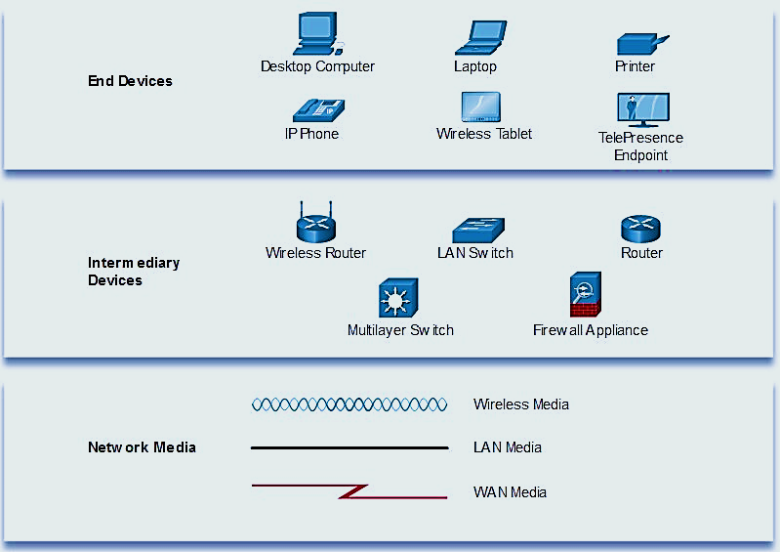
NETWORK REPRESENTATION AND TOPOLOGIES
Network diagrams, often called topology diagrams, use symbols to represent devices within the network.​
important terms to know include:​
Network interface card (NIC)​
Physical port​
Interface​
​
Note: often, the terms port and interface are used interchangeably

Slide 12
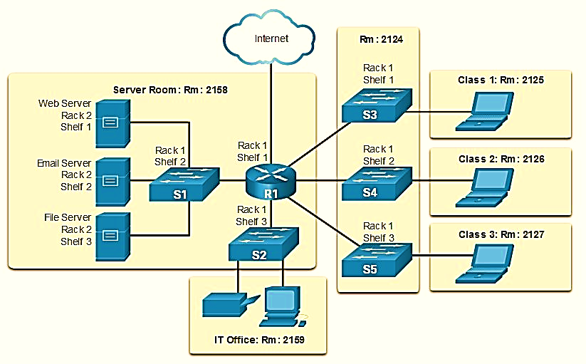
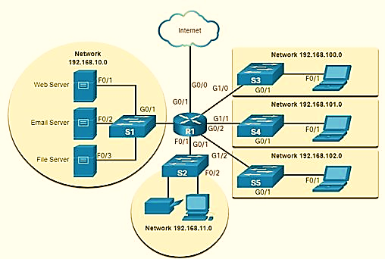
Network Representations and Topologies​
Topology Diagrams
Physical topology diagrams illustrate the physical location of intermediary devices and cable installation.
Logical topology diagrams illustrate devices, ports, and the addressing scheme of the network.​

Slide 13
COMMON NETWORK TYPES

Slide 14
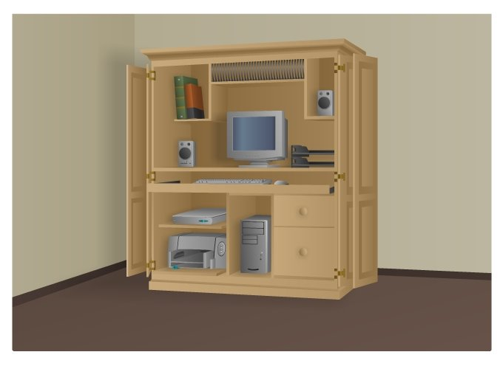
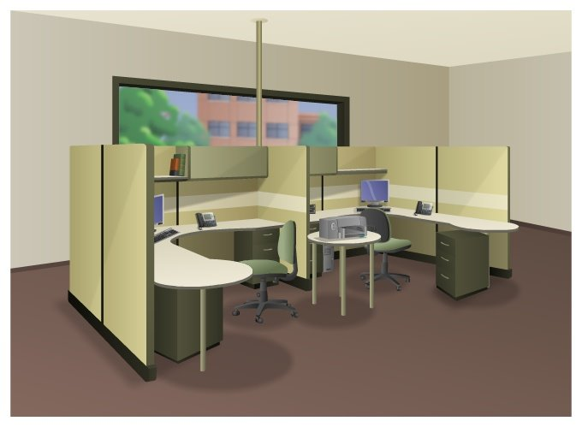
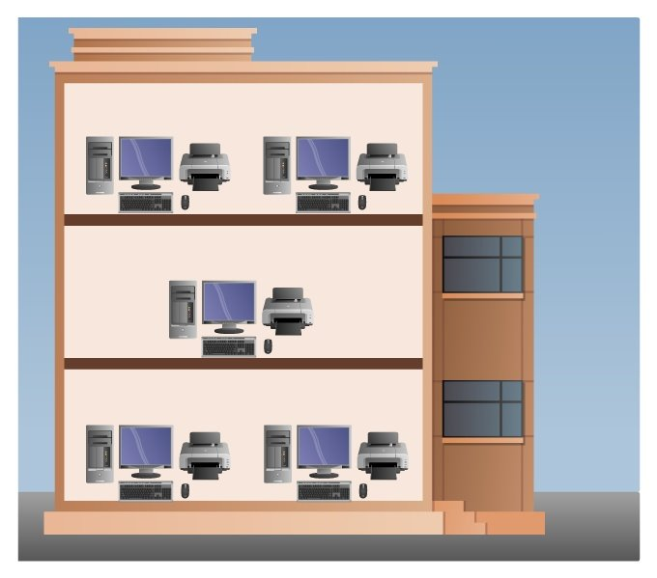
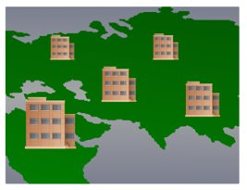
COMMON NETWORK TYPES
Small Home Networks – connect a few computers to each other and the Internet​
Small Office/Home Office – enables computer within a home or remote office to connect to a corporate network​
Medium to Large Networks – many locations with hundreds or thousands of interconnected computers
World Wide Networks – connects hundreds of millions of computers world-wide – such as the internet
Small Home SOHO
Medium/Large World Wide

Slide 15

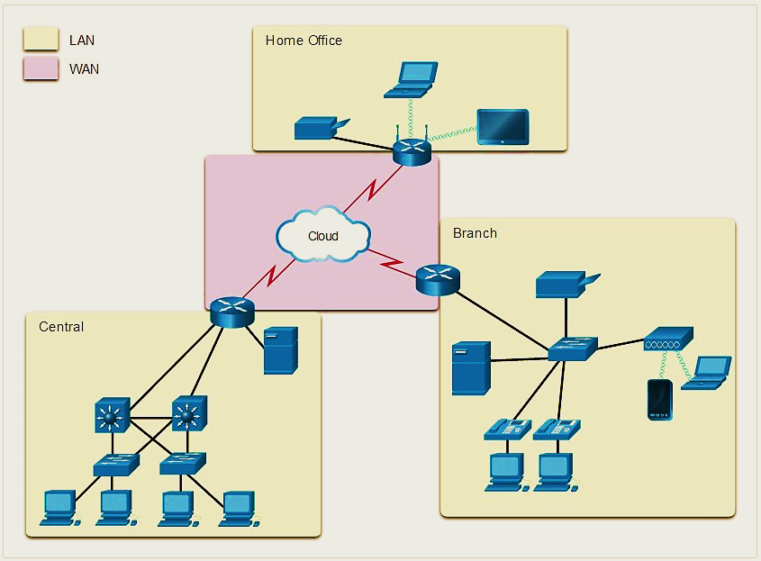
Common Types of Networks​
LANs & WANs
Network infrastructures vary greatly in terms of:​
Size of the area covered​
Number of users connected​
Number and types of services available​
Area of responsibility​​
Two most common types of networks: ​
local area network (LAN) ​
wide area network (WAN).

Slide 16
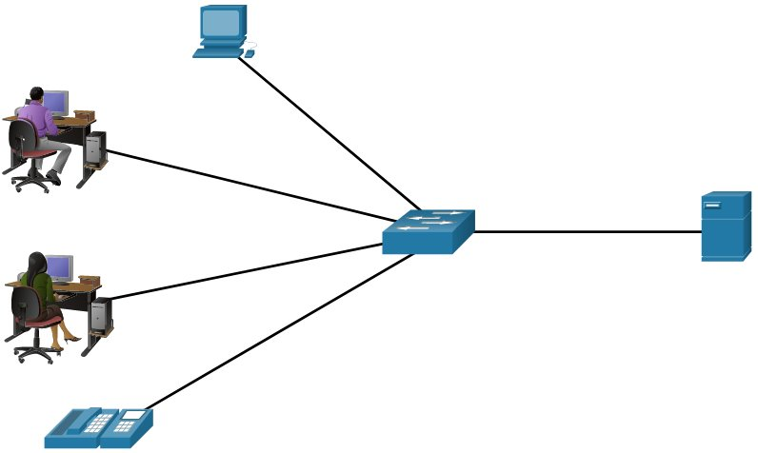
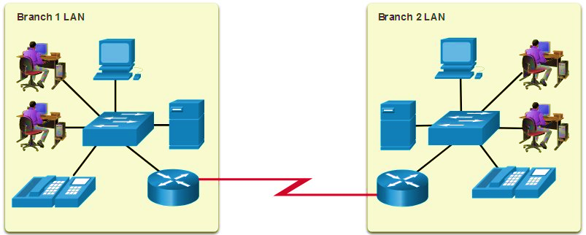
Common Types of Networks​
LANs and WANs
LAN | WAN
Interconnect end devices in a limited area. | Interconnect LANs over wide geographical areas.
Administered by a single organization or individual. | Typically administered by one or more service providers.
Provide high-speed bandwidth to internal devices. | Typically provide slower speed links between LANs.

Slide 17
INTERNET CONNECTIONS

Slide 18
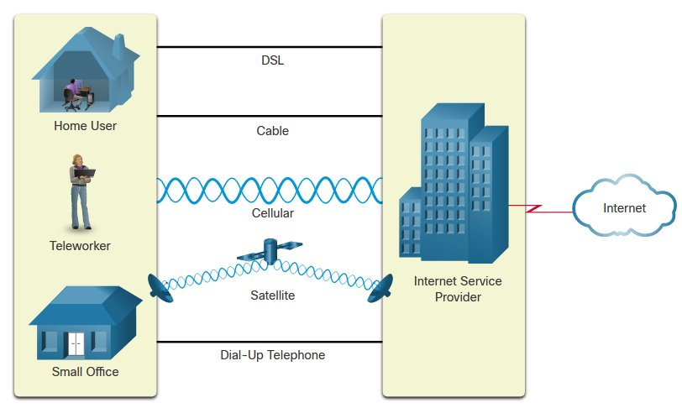
Common Types of Networks​
LANs and WANs
Connection | Description
Cable | high bandwidth, always on, internet offered by cable television service providers.
DSL | high bandwidth, always on, internet connection that runs over a telephone line.
Cellular | uses a cell phone network to connect to the internet.
Satellite | major benefit to rural areas without Internet Service Providers.
Dial-up telephone | an inexpensive, low bandwidth option using a modem.

Slide 19
RELIABLE NETWORKS

Slide 20
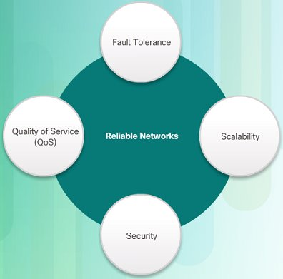
RELIABLE NETWORKS
NETWORK ARCHITECTURE
Network Architecture refers to the technologies that support the infrastructure that moves data across the network.​
There are four basic characteristics that the underlying architectures need to address to meet user expectations:​
Fault Tolerance​
Scalability​
Quality of Service (QoS)​
Security

Slide 21
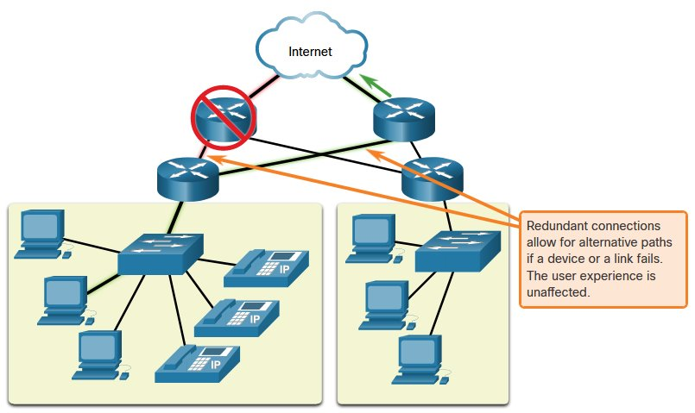
RELIABLE NETWORKS
Fault Tolerance
A fault tolerant network limits the impact of a failure by limiting the number of affected devices.
Multiple paths are required for fault tolerance.​
Reliable networks provide redundancy by implementing a packet switched network:​
  Packet switching splits traffic into packets that are routed over a network.
  Each packet could theoretically take a different path to the destination.​
This is not possible with circuit-switched networks which establish dedicated circuits.

Slide 22
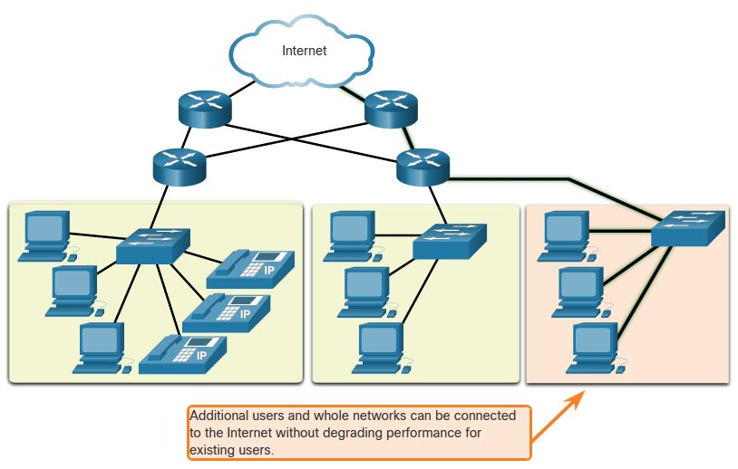
RELIABLE NETWORKS sCALABILITY
A scalable network can expand quickly and easily to support new users and applications without impacting the performance of services to existing users.​
Network designers follow accepted standards and protocols in order to make the networks scalable.​

Slide 23
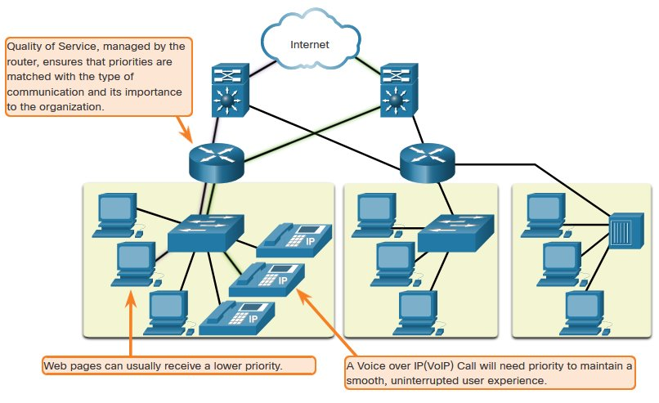
RELIABLE NETWORKS
Quality of Service
Voice and live video transmissions require higher expectations for those services being delivered.
Have you ever watched a live video with constant breaks and pauses? This is caused when there is a higher demand for bandwidth than available – and QoS isn’t configured.
  Quality of Service (QoS) is the primary mechanism used to ensure reliable delivery of content for all users.
  With a QoS policy in place, the router can more easily manage the flow of data and voice traffic.

